Slide 1
IM Proposal
Instant Messaging FiNal Presentation
By: Douglas Toblert-Cooke, Andrew Rivera, Linner Rivas

Slide 2
Our Developers & roles
Douglas Tolbert-Cooke
DEV LEAD
Java
GUI
Andrew Rivera
QA LEAD
Java
GUI
Linner Rivas
SCRUM MASTER
Java
SQL
GUI

Slide 3
LANGUAGE/ENVIRONMENT USED
Coded in Java
MySQL
Html/css
JavaScript
Coded using Eclipse
Using Github

Slide 4
Our Developer background

Slide 5
Douglas Tolbert-Cooke
My name is Douglas Tolbert-Cooke and I am a senior majoring in Computer Science. I am equally knowledgeable in Python as I am Java. However, I've only taken half of each one class wise. I'm currently in a Python class so I guess I'm currently better with Python. I've used IDLE and Eclipse as my programming platforms. I have general networking knowledge but anything I do not understand I can obtain the information.

Slide 6
Andrew Rivera
My name is Andrew Rivera, I'm currently a senior going for a bachelor's degree in Computer science, with a focus in Information systems. I have taken multiple classes using java as a programming language and I feel the most comfortable using that for this project. I also have a semester's worth of experience using python, JavaScript, CSS, html, GUI, and SQL. I use brackets and notepad++ as my development platforms for the majority of the coding that I do. I have a general knowledge in networking but nothing of significance.

Slide 7
Linner Rivas
My name is Linner Rivas, I am currently a senior going for my bachelor’s degree in Computer science focused on Computer Information System. I have my associate in computer information system. I have learned the skills of programming in the basic language in java, python, html, css, JavaScript, c++ , c# and I do have a lot of skills base in database(SQL). The development platform that I use a is notepad++ and Visual studio. I have a general knowledge of networking but if I have a problem or I don’t understand, I would google it anything on networking. I work in a IT, networking and development company.

Slide 8
Possible Layout

Slide 9
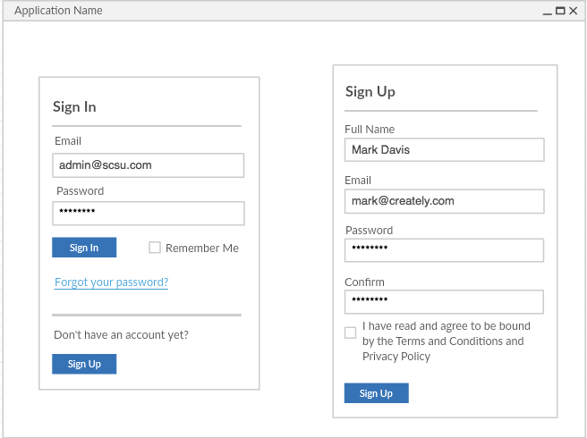
Layout 1
The first page that comes up is the sign in page.
Contents the following:
Sign in area
Sign up area

Slide 10
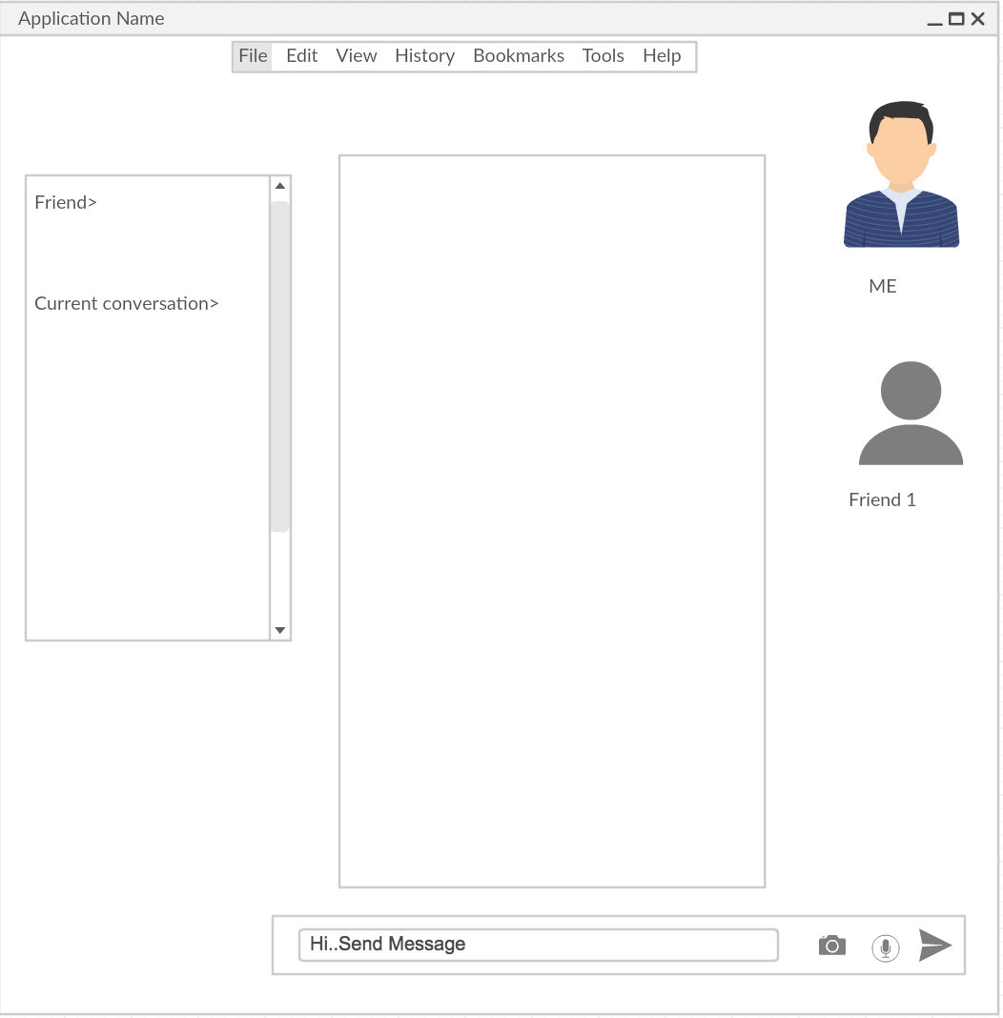
Layout 2
Image of the user or emoji image
The side bar contents the :
Friends that are connected.
Friends that are disconnected.
Your Conversation history.
Text Message input.
Top Bar menu:
File
Edit
View
History
Tools
Help
Message Display

Slide 11
Issue and Resolution Layout

Slide 12
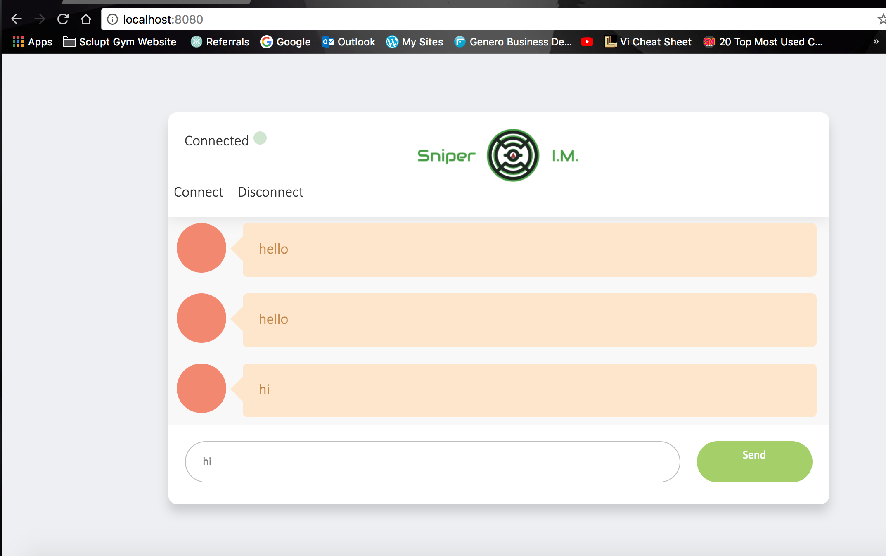
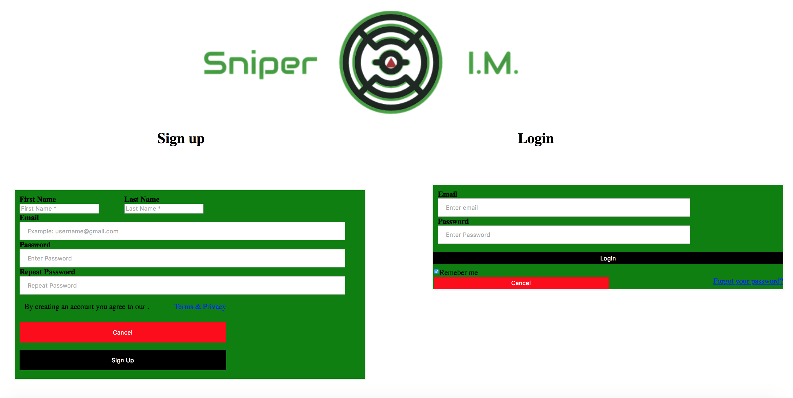
THE BEGINNING OF THE WEB-BASE CHAT

Slide 13

WE RAN INTO ISSUES!
WE WERE GOING GOOD UNTIL:
Going good with:
Chat html
Login html
JavaScript
Java code
The issue:
Merging the html code with the java.
Change the java to webframe work.(more Issues.)
Only messager work not login and sign up.

Slide 14
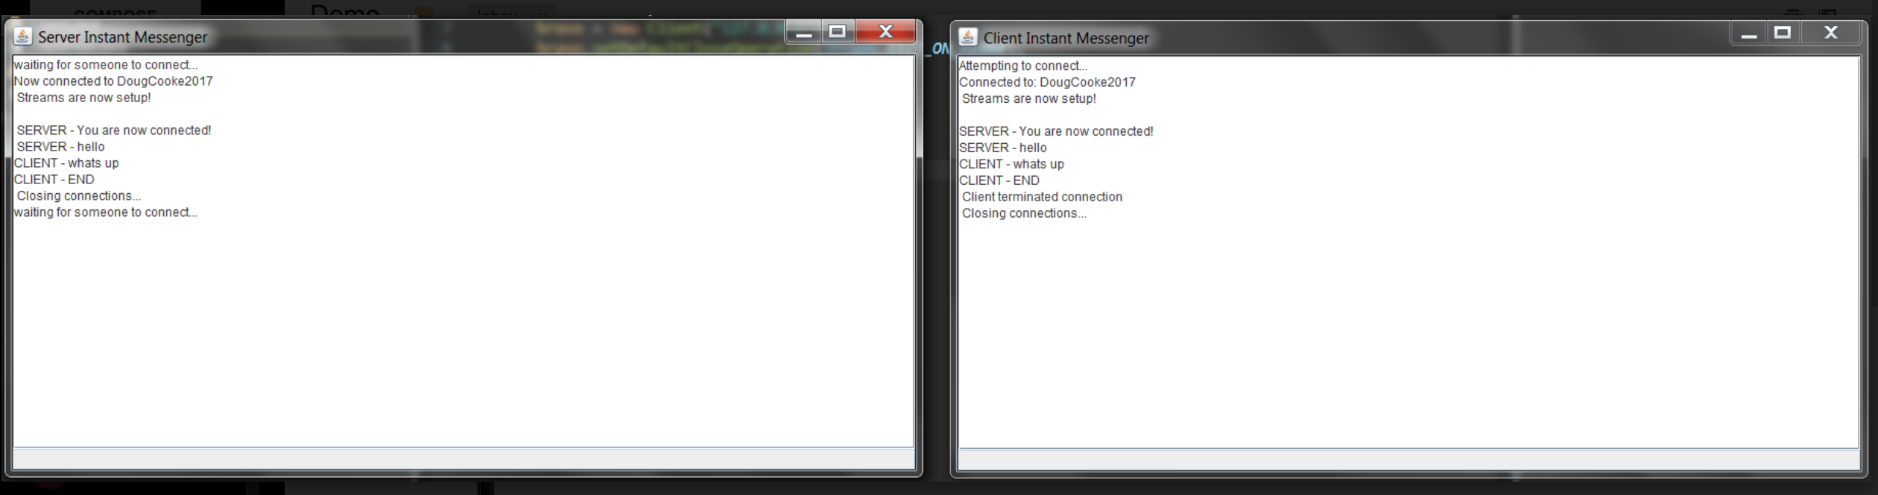
Then we Switch it to Sockets.
We move to keeping it simple:
We created a Desktop java gui.
With sockets.
Simple gui (User friendly.)
We were able to know when user was talking to each other.
Java
Java frame.
(We will improve the Gui and application.)

